Slide 1
Final review
Weiqiang Sun

Slide 2
Final exam
12/29/2012, Saturday
08:00－10:00
East Upper Hall (东上院) 202

Slide 3
Scope
Covered
Chapter 1 ~ 9, 12
Not covered
Chapter 10, 11, 13, 14
Trouble Shooting
System Application Activity
Design with HDLs

Slide 4
Chapter 1 & 2
Logic Levels (Noise margin, compatibility)
Number systems (bin, octet, hex…)
Conversions
Arithmetic
1’s and 2’s complements, signed numbers
Codes
BCD, Gray codes

Slide 5
Chapter 3 & 4
Basic gates (inverter, AND, OR, NAND, NOR, XOR, XNOR), their functions and symbols
Universality of NAND and NOR gates
AND-OR logic
Boolean rules and Axioms
Simplifications
Analysis of combinational circuits
Standard forms
minterms, maxterms, standard SOP, standard POS
K-map
SOP minimization

Slide 6
Chapter 5 & 6
Analysis of combinational logic
Implementing combinational logic with basic gates
Functions of combinational logic circuits
Adders, comparators, decoders, encoders, code converters, MUX, parity checker
Design Logic with IC
With decoders
With MUX

Slide 7
Chapter 7 Flip-flops
Bi-stable device
Latch (S-R, S’-R’)
Flip-flops
D, J-K
Their symbols
Flip-flops with asynchronous set/reset
Operating characteristics of FF
Setup time, hold time, max clock frequency
Applications of FF
Timers
One-shot
555 timer (multi-vibrator, one-shots)

Slide 8
Chapter 8 Counters
Asynchronous Counters
Synchronous Counters
Design of counters with FF
Design of counters with IC
Synchronous load
Asynchronous reset

Slide 9
Chapter 9 Shift Registers
Shift register operations
Serial in/Serial out, Serial in/Parallel out, Parallel in/Serial out, Parallel in/Parallel out
Shift Register Counters
Johnson Counter
Ring Counter
Applications of SR
Serial to parallel conversion

Slide 10
Chapter 12
D/A conversion
Binary-weighted-input DAC
R-2R ladder DAC
Accuracy and resolution
A/D conversion
Flash ADC
Dual Slope ADC
Successive-approximation ADC
Sigma-delta ADC

Slide 11
Examples of Counters and Shift Registers
Counters
Counter analysis (Sequential logic circuit analysis)
Design counters with F-Fs
Design counters with IC counters.

Slide 12
Example 1
Design a counter with the counting sequence 0-1-3-5-7-6-4-2-0-1 using J-K Flip-flips

Slide 13
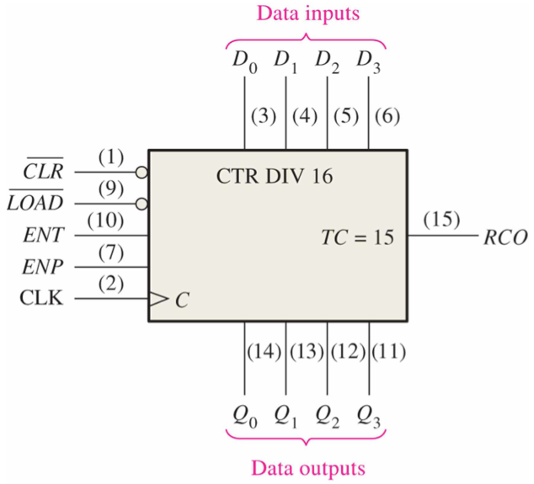
Example 2
Design a modulus-40,000 counter with modulus-16 counters (74HC163). (pp.448)
Method 1: Load a pre-configured number
Method 2: Reset the Counter at some state

