Slide 1
K-MAP, Race and Hazards
Weiqiang Sun

Slide 2
Adjacency in Four-variable K-Map

Slide 3
Adjacency in Four-variable K-Map

Slide 4
Adjacency in Four-variable K-Map

Slide 5
Adjacency in Four-variable K-Map

Slide 6
Adjacency in Four-variable K-Map

Slide 7
Adjacency in Four-variable K-Map
Can we group 12 cells?
NO!

Slide 8
Adjacency in Four-variable K-Map
X
+W
Group only 2^{i} cells, 0<=i<=N, N is the number of variables

Slide 9
Adjacency in 5-variable K-Map

Slide 10
Adjacency in 5-variable K-Map

Slide 11
Adjacency in 5-variable K-Map

Slide 12
Adjacency in 5-variable K-Map

Slide 13
Adjacency in 5-variable K-Map

Slide 14
Adjacency in 5-variable K-Map
Center symetric

Slide 15
Adjacency in 5-variable K-Map
Center symetric

Slide 16
Simplification to POS
K-Map can also be used to simplify a function to minimum POS by grouping adjacent “0”s.
Group 2^{i} cells, 0<=i<=N, N is the number of variables.
Variables that change within a group is eliminated.
Read a variable as its true form for “0” cells, and as its complemented form for “1” cells.

Slide 17
Simplification to POS
Example
Simplify the function below to minimum POS:
F＝ Σ_{W,X,Y,Z} (2, 6, 7, 9, 13, 15)
Solution

Slide 18
Simplification to POS
Example
Simplify the function below to minimum POS:
F＝ Σ_{W,X,Y,Z} (2, 6, 7, 9, 13, 15)
Solution
(2)
(1)
(1)
(2)
(3)
(3)

Slide 19
Race and Hazards
Look at the circuit below:
When X changes from “1” to “0”, the change arrives at gate Y at different time (race), causing a momentary LOW output on Y. That is called a static “1” hazard.

Slide 20
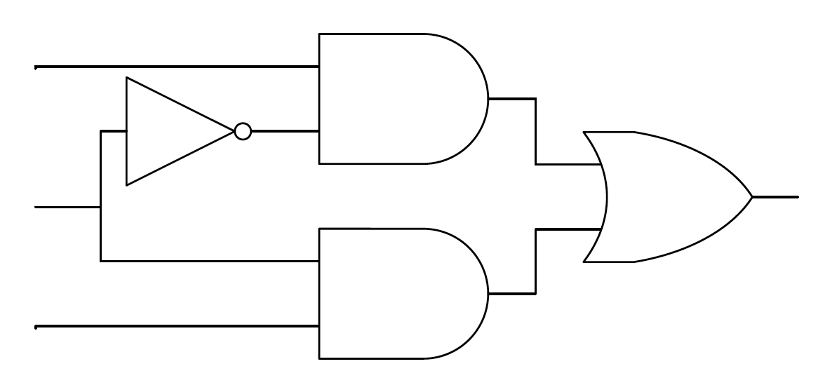
Race and Hazards
Another example:
A
C
X
B
When ABC changes from 111 to 110, race occurs at the input of the OR gate.

Slide 21
Another type of race…
Look at the circuit below:
When X changes from “0” to “1”, the change arrives at gate Y at different time (race), causing a momentary HIGH output on Y. That is called a static “0” hazard.

Slide 22
Race and Hazards
Static 1 hazards
Static 0 hazards

Slide 23
Detecting and avoiding hazards
AB
C
00
01
11
10
0 | 0 | 1 | 1
0 | 1 | 1 | 0
AC’
With K-Map, hazards may be detected by spotting input changes from one group to another.
0
1
BC
F = AC’ + BC

Slide 24
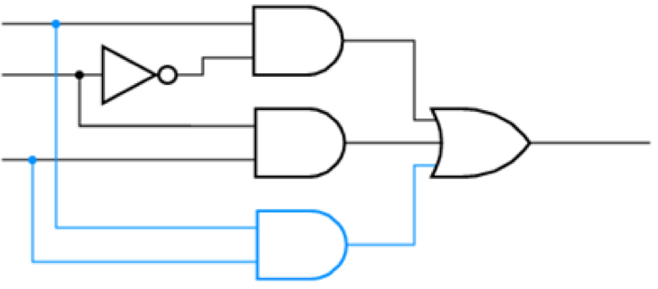
Detecting and avoiding hazards
AB
AB
00
01
11
10
C
00
01
11
10
C
0 | 0 | 1 | 1
0 | 1 | 1 | 0
AC’
0 | 0 | 1 | 1
0 | 1 | 1 | 0
AC’
0
0
1
BC
1
BC
F = AC’ + BC
F = AC’ + BC + AB
AB
Hazards may be avoided by avoiding input changes from one group to another, and this can be done by adding redundant inputs (product terms) to the OR gate.

Slide 25
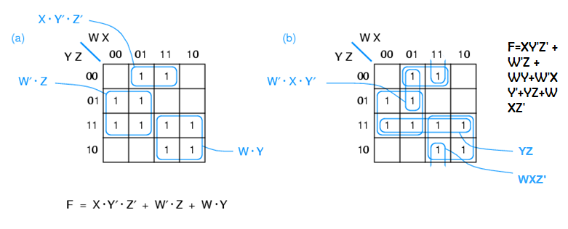
Ways to detect and avoid hazards
Example
Detect possible races in the K-Map below and eliminate them.

Slide 26
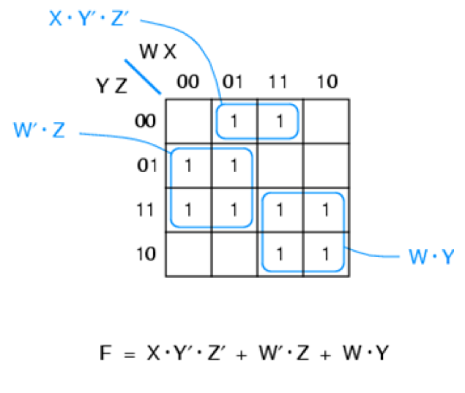
Detecting and avoiding hazards
Example
Detect possible races in the K-Map below and eliminate them.
Solution
+W’XY’+YZ+WXZ’

